Slide 1
NPTEL
Video Course on Machine Learning
Professor Carl Gustaf Jansson, KTH
Week 2 Characterization of
Learning Problems
Video 2.1 Characterization of
Learning Problems

Slide 2
Major Distinction regarding the role of Machine Learning
Data Analysis
Adaptive Systems
The distinction is still very relevant for sorting out and understanding various approaches to Machine Learning,
..but the borderline between the two genres tend to become increasingly blurred.
The major reason for all learning is after all ultimately to act better in future situations.

Slide 3
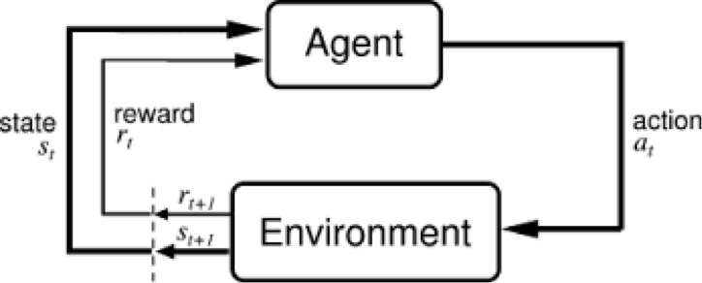
Major Machine Learning Contribution to Adaptive Systems
Reinforcement Learning
Reinforcement learning is
concerned with how agents
take actions in an environment
and changing state so as to maximize
some notion of cumulative reward.
It is assumed that the agent can
concisely manage the handling of
the reward so that components
of the agent can be modified
(given credit or blame inferred from
the reward) to produce a new state.

Slide 4
Re-inforcement Learning
It is assumed that the agent can concisely manage the handling of the reward so that components of the agent can be modified to produce a new state. (given detailed credit or blame inferred from the reward),
It is further assumed that the typical scenario for re-inforcement learning, is a strong-theory-based hardware and software system
and that adaption happens on the margin of the systems behaviour.
A typical way of modelling the environment is the use of Markov Decision Processes in turn applying Dynamic Programming.
As we will see later in the course, re-inforcement learning can be realized in many different shapes.

Slide 5
Data Analysis
The End-to-end process for Real-World problems
In a typical machine learning application, practitioners must apply the appropriate:
Data harvesting from potentially heterogeneous sources
Pre-processing of data (e.g. from analogue to digital form)
Model or theory support
Feature engineering
Algorithm selection
Tailoring conditions for algorithms
(hyper-parameter settings, language biases, complexity)
Core analysis phase
Post-processing of acquired knowledge
Visualization and preparation of material for on-line updating and decision making.
Machine
Learning

Slide 6
Main Scenarios for Data Analysis
Regression establishing prognosis of future states
Classification establishing concepts for classifying in future situations

Slide 7
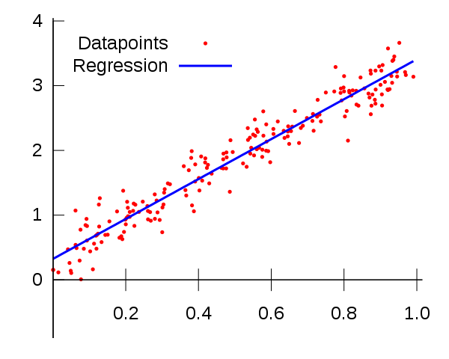
Regression
Regression is a technique
from statistics that is used to
predict values of a
desired target quantity when
the target quantity is ´continuous´.
It is obviously the case that
the target quantity can be complex
and typically multi dimensional in
contrast to this simple example.

Slide 8
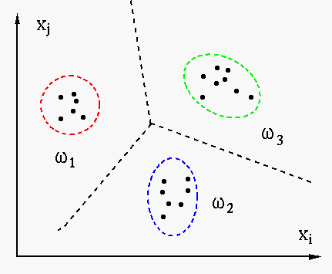
Classification
Classification predicts discrete number
of values.
In classification the data is categorized
under different labels according to some
parameters and then the labels are
predicted for the data.
It is obviously the case that the space of
Classification is typically multi dimensional
in contrast to the example.

Slide 9
The rest of this week will be focussed on Classification or synonymously Concept Learning
The coming lectures will be structured as follows:
Lecture 2.2 Objects, Categories and Features
Lecture 2.3 Feature related issues
Lecture 2.4 Scenarios for Learning
Lecture 2.5 Tutorial on Assignments
Distinctions such as supervised vs un-supervised, on-line vs off-line and instanced-based vs abstraction-based learning will be covered primarily in lecture 2.4.
Before we end this lecture we will introduce an example that will be systematically referred to in the following lectures.

Slide 10
Example - the ZOO Dataset – from the UCI ML repository
The UCI Machine Learning Repository maintains 351 data sets
as a service to the machine learning community.
The example dataset is a naive and partial classification of animals
107 objects characterized by 18 features classified in 7 categories

Slide 11
Category structure
Animal
Mammal(#1)
Bird(#2)
Reptile(#3)
Fish(#4)
Amphibian(#5)
Insect(#6)
Invertebrate(#7)

Slide 12
Features
animal_name
hair
feathers
eggs
milk
airborne
aquatic
predator
toothed
backbone
breathes
venomous
fins
legs
tail
domestic
catsize
class_type
All features are Boolean except the animal-name
which is a text and class-type and legs which are integers.

Slide 13
Zoo Dataset (107 objects)
aardvark,1,0,0,1,0,0,1,1,1,1,0,0,4,0,0,1,1 antelope,1,0,0,1,0,0,0,1,1,1,0,0,4,1,0,1,1 bass,0,0,1,0,0,1,1,1,1,0,0,1,0,1,0,0,4 bear,1,0,0,1,0,0,1,1,1,1,0,0,4,0,0,1,1 boar,1,0,0,1,0,0,1,1,1,1,0,0,4,1,0,1,1 buffalo,1,0,0,1,0,0,0,1,1,1,0,0,4,1,0,1,1 calf,1,0,0,1,0,0,0,1,1,1,0,0,4,1,1,1,1 carp,0,0,1,0,0,1,0,1,1,0,0,1,0,1,1,0,4 catfish,0,0,1,0,0,1,1,1,1,0,0,1,0,1,0,0,4 cavy,1,0,0,1,0,0,0,1,1,1,0,0,4,0,1,0,1 cheetah,1,0,0,1,0,0,1,1,1,1,0,0,4,1,0,1,1 chicken,0,1,1,0,1,0,0,0,1,1,0,0,2,1,1,0,2 chub,0,0,1,0,0,1,1,1,1,0,0,1,0,1,0,0,4 clam,0,0,1,0,0,0,1,0,0,0,0,0,0,0,0,0,7 crab,0,0,1,0,0,1,1,0,0,0,0,0,4,0,0,0,7 crayfish,0,0,1,0,0,1,1,0,0,0,0,0,6,0,0,0,7 crow,0,1,1,0,1,0,1,0,1,1,0,0,2,1,0,0,2 deer,1,0,0,1,0,0,0,1,1,1,0,0,4,1,0,1,1 dogfish,0,0,1,0,0,1,1,1,1,0,0,1,0,1,0,1,4 dolphin,0,0,0,1,0,1,1,1,1,1,0,1,0,1,0,1,1 dove,0,1,1,0,1,0,0,0,1,1,0,0,2,1,1,0,2 duck,0,1,1,0,1,1,0,0,1,1,0,0,2,1,0,0,2 elephant,1,0,0,1,0,0,0,1,1,1,0,0,4,1,0,1,1 flamingo,0,1,1,0,1,0,0,0,1,1,0,0,2,1,0,1,2 flea,0,0,1,0,0,0,0,0,0,1,0,0,6,0,0,0,6 frog,0,0,1,0,0,1,1,1,1,1,0,0,4,0,0,0,5 frog,0,0,1,0,0,1,1,1,1,1,1,0,4,0,0,0,5 fruitbat,1,0,0,1,1,0,0,1,1,1,0,0,2,1,0,0,1 giraffe,1,0,0,1,0,0,0,1,1,1,0,0,4,1,0,1,1 girl,1,0,0,1,0,0,1,1,1,1,0,0,2,0,1,1,1 gnat,0,0,1,0,1,0,0,0,0,1,0,0,6,0,0,0,6 goat,1,0,0,1,0,0,0,1,1,1,0,0,4,1,1,1,1 gorilla,1,0,0,1,0,0,0,1,1,1,0,0,2,0,0,1,1 gull,0,1,1,0,1,1,1,0,1,1,0,0,2,1,0,0,2 haddock,0,0,1,0,0,1,0,1,1,0,0,1,0,1,0,0,4 hamster,1,0,0,1,0,0,0,1,1,1,0,0,4,1,1,0,1 hare,1,0,0,1,0,0,0,1,1,1,0,0,4,1,0,0,1 hawk,0,1,1,0,1,0,1,0,1,1,0,0,2,1,0,0,2 herring,0,0,1,0,0,1,1,1,1,0,0,1,0,1,0,0,4 honeybee,1,0,1,0,1,0,0,0,0,1,1,0,6,0,1,0,6 housefly,1,0,1,0,1,0,0,0,0,1,0,0,6,0,0,0,6 kiwi,0,1,1,0,0,0,1,0,1,1,0,0,2,1,0,0,2 ladybird,0,0,1,0,1,0,1,0,0,1,0,0,6,0,0,0,6 lark,0,1,1,0,1,0,0,0,1,1,0,0,2,1,0,0,2 leopard,1,0,0,1,0,0,1,1,1,1,0,0,4,1,0,1,1 lion,1,0,0,1,0,0,1,1,1,1,0,0,4,1,0,1,1 lobster,0,0,1,0,0,1,1,0,0,0,0,0,6,0,0,0,7 lynx,1,0,0,1,0,0,1,1,1,1,0,0,4,1,0,1,1 mink,1,0,0,1,0,1,1,1,1,1,0,0,4,1,0,1,1 mole,1,0,0,1,0,0,1,1,1,1,0,0,4,1,0,0,1 mongoose,1,0,0,1,0,0,1,1,1,1,0,0,4,1,0,1,1 moth,1,0,1,0,1,0,0,0,0,1,0,0,6,0,0,0,6 newt,0,0,1,0,0,1,1,1,1,1,0,0,4,1,0,0,5 octopus,0,0,1,0,0,1,1,0,0,0,0,0,8,0,0,1,7 opossum,1,0,0,1,0,0,1,1,1,1,0,0,4,1,0,0,1 oryx,1,0,0,1,0,0,0,1,1,1,0,0,4,1,0,1,1 ostrich,0,1,1,0,0,0,0,0,1,1,0,0,2,1,0,1,2 parakeet,0,1,1,0,1,0,0,0,1,1,0,0,2,1,1,0,2 penguin,0,1,1,0,0,1,1,0,1,1,0,0,2,1,0,1,2 pheasant,0,1,1,0,1,0,0,0,1,1,0,0,2,1,0,0,2 pike,0,0,1,0,0,1,1,1,1,0,0,1,0,1,0,1,4 piranha,0,0,1,0,0,1,1,1,1,0,0,1,0,1,0,0,4 pitviper,0,0,1,0,0,0,1,1,1,1,1,0,0,1,0,0,3 platypus,1,0,1,1,0,1,1,0,1,1,0,0,4,1,0,1,1 polecat,1,0,0,1,0,0,1,1,1,1,0,0,4,1,0,1,1 pony,1,0,0,1,0,0,0,1,1,1,0,0,4,1,1,1,1 porpoise,0,0,0,1,0,1,1,1,1,1,0,1,0,1,0,1,1 puma,1,0,0,1,0,0,1,1,1,1,0,0,4,1,0,1,1 pussycat,1,0,0,1,0,0,1,1,1,1,0,0,4,1,1,1,1 raccoon,1,0,0,1,0,0,1,1,1,1,0,0,4,1,0,1,1 reindeer,1,0,0,1,0,0,0,1,1,1,0,0,4,1,1,1,1 rhea,0,1,1,0,0,0,1,0,1,1,0,0,2,1,0,1,2 scorpion,0,0,0,0,0,0,1,0,0,1,1,0,8,1,0,0,7 seahorse,0,0,1,0,0,1,0,1,1,0,0,1,0,1,0,0,4 seal,1,0,0,1,0,1,1,1,1,1,0,1,0,0,0,1,1 sealion,1,0,0,1,0,1,1,1,1,1,0,1,2,1,0,1,1 seasnake,0,0,0,0,0,1,1,1,1,0,1,0,0,1,0,0,3 seawasp,0,0,1,0,0,1,1,0,0,0,1,0,0,0,0,0,7 skimmer,0,1,1,0,1,1,1,0,1,1,0,0,2,1,0,0,2 skua,0,1,1,0,1,1,1,0,1,1,0,0,2,1,0,0,2 slowworm,0,0,1,0,0,0,1,1,1,1,0,0,0,1,0,0,3 slug,0,0,1,0,0,0,0,0,0,1,0,0,0,0,0,0,7 sole,0,0,1,0,0,1,0,1,1,0,0,1,0,1,0,0,4 sparrow,0,1,1,0,1,0,0,0,1,1,0,0,2,1,0,0,2 squirrel,1,0,0,1,0,0,0,1,1,1,0,0,2,1,0,0,1 starfish,0,0,1,0,0,1,1,0,0,0,0,0,5,0,0,0,7 stingray,0,0,1,0,0,1,1,1,1,0,1,1,0,1,0,1,4 swan,0,1,1,0,1,1,0,0,1,1,0,0,2,1,0,1,2 termite,0,0,1,0,0,0,0,0,0,1,0,0,6,0,0,0,6 toad,0,0,1,0,0,1,0,1,1,1,0,0,4,0,0,0,5 tortoise,0,0,1,0,0,0,0,0,1,1,0,0,4,1,0,1,3 tuatara,0,0,1,0,0,0,1,1,1,1,0,0,4,1,0,0,3 tuna,0,0,1,0,0,1,1,1,1,0,0,1,0,1,0,1,4 vampire,1,0,0,1,1,0,0,1,1,1,0,0,2,1,0,0,1 vole,1,0,0,1,0,0,0,1,1,1,0,0,4,1,0,0,1 vulture,0,1,1,0,1,0,1,0,1,1,0,0,2,1,0,1,2 wallaby,1,0,0,1,0,0,0,1,1,1,0,0,2,1,0,1,1 wasp,1,0,1,0,1,0,0,0,0,1,1,0,6,0,0,0,6 wolf,1,0,0,1,0,0,1,1,1,1,0,0,4,1,0,1,1 worm,0,0,1,0,0,0,0,0,0,1,0,0,0,0,0,0,7 wren,0,1,1,0,1,0,0,0,1,1,0,0,2,1,0,0,2

Slide 14
NPTEL
Video Course on Machine Learning
Professor Carl Gustaf Jansson, KTH
Thanks for your attention!
The next lecture 2.2 will be on the
topic:
Objects, Categories and Features

